Slide 1
Electrical Safety at Work

Slide 2
Meet Your Panelist
Mike Carter

Slide 3
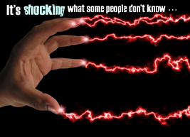
Contents
Dangers of Electrical Shock
Recognizing Hazards Hazards
Safe Work Practices
Protection Devices
Safety Ideas
Source: www.lanl.gov
Notes:
There were 146 electrocution deaths per year on average from 2015 through 2018 (one every 3 days). There were also 1,977 electrical injuries each year during that period each requiring 4 days away from work on average. In 2018, 9% of all electrical injuries were fatal.
Littelfuse, Inc. surveyed almost 600 people who work directly with electricity in early 2020.
62% of those who said they consider up to 500V to be a safe working voltage reported having experienced electrical shock by more than 220V while on the job.
86% of those who said they have experienced electrical shock by more than 220V also rated themselves as either “very confident” or “extremely confident” in their ability to recognize an electrical hazard.
There is a lot of information to cover today, but there is a lot at stake.

Slide 4
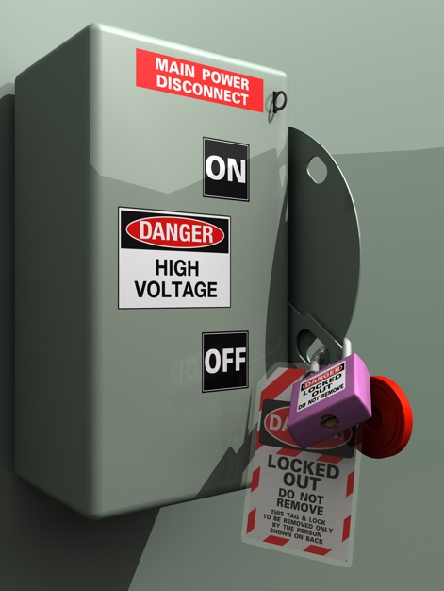
Dangers of Electrical Shock
Top OSHA Violations
Fall Protection
Hazard Communication
Scaffolding
Lockout/Tagout
Respiratory Protection
Ladders
Powered Industrial Trucks
Fall protection training
Machine Guarding
Eye and face protection
Notes:
The top 10 violations seen by OSHA in fiscal year 2019 are as follows. An electrical safety violation, Lockout/Tagout, ranked #4 overall.
The following hazards are the most frequent cause of electrical injuries [OSHA 29 CFR 1926.416(a)(1)]:
Contact with Power Lines
Lack of Ground-fault Protection
Path to Ground Missing or Discontinuous
Equipment Not Used in Manner Prescribed
Improper Use of Extension and Flexible Cords

Slide 5
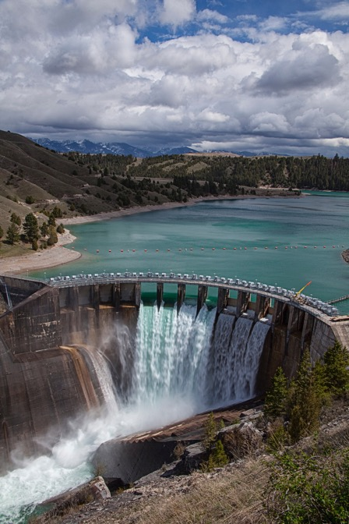
Dangers of Electrical Shock
Shock
When a circuit, electrical component, or equipment shock hazard is present.
Touching a live wire while grounded
Touching a live wire and another live wire
Electric voltage potential
Car battery (12 V)
Electrical outlet (120 V)
Clothes dryer (240 V)
Utility distribution (13,200 V)
Utility transmission (230,000 V)
Notes:
Three electrical metrics are involved in shock and burns: voltage, current, and resistance. Electrical voltage provides the push or force that moves current through a circuit against resistance. It is like water behind a dam. The higher the dam water level. the more force behind the water that is released. Your car battery provides 12V, your electrical outlet 120V, and your electric clothes dryer 240V. Sometimes high voltages lead to additional injuries. High voltages can cause violent muscular contractions. You may lose your balance and fall, which can cause injury or even death if you fall into machinery that can crush you.

Slide 6
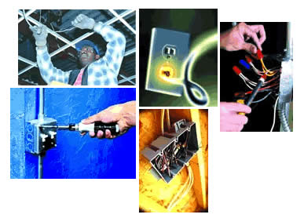
Dangers of Electrical Shock
Shock
Current
Flow of electric charges (amperes)
I = V/R
Resistance
Resistance to flow of current (ohms)
R = 1,000 ohms (wet skin)
R = 100,000 ohms (dry skin)
Example:
120 volts @1,000 ohms
I = 120/1,000 = 0.12 amps = 120 ma (milliamps)
Source: www.cdc.gov
Notes:
Current is the flow of electrical charge measured in amperes. Current is like water flow through a pipe. It is proportional to the voltage. Resistance reduces current flow, but produces heating.
It is related to voltage and resistance as follows:
Electric current = Voltage/Resistance
Both lower voltage and high resistance restricts current flow.
Resistance (low conductivity) is the opposition to the flow of electric current measured in ohms. Materials with low conductivity like rubber, wood and plastics have high electrical resistance (>1,000 ohms). Our bodies have very high resistance: 1,000 ohms with wet skin and 100,000 ohms for dry skin.
Using our formula above for electrical outlet voltage (120V) and wet skin resistance (1,000 ohms) indicates painful shock and possible death from current flow. Per the chart on the next page.

Slide 7
Dangers of Electrical Shock
Shock Effects
Effects of Electrical Current in the Body (<600V, 1 second)
Current (milliamps) | Reaction
1 | Just a faint tingle.
5 | Slight shock felt. Disturbing, but not painful. Most people can "let go." However, strong involuntary movements can cause injury.
6-30 | Painful shock. Muscular control is lost. This is the range where "freezing currents" start. It may not be possible to "let go."
50-150 | Extremely painful shock, respiratory arrest (breathing stops), severe muscle contractions. Flexor muscles may cause holding on; extensor muscles may cause intense pushing away. Death is possible.
1,000-4,300 (4.3 amps) | Ventricular fibrillation (heart pumping action not rhythmic) occurs. Muscles contract; nerve damage occurs. Death is likely.
10,000 (10 amps) | Cardiac arrest and severe burns occur. Death is probable.
15,000 (15 amps) | Lowest overcurrent at which a typical fuse or circuit breaker opens a circuit!
120 ma
Notes:
Our heart operates on electrical impulses and is very susceptible to current flow. Even a few thousandths of an ampere (milliamps) flow across our chest can be painful or even deadly. The following chart shows the effects of different amounts of current flow through our body.
A current flow of 120 ma for one second produces extremely painful shock!! One amp (1,000 ma) can certainly kill you.

Slide 8
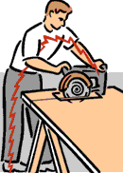
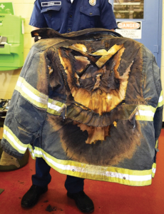
Dangers of Electrical Shock
Shock
Magnitude
Duration
120 ma @1 sec ≈ 1,200 ma @0.1 sec (6cycles)Path
Burns
Temperatures as high as 35000°F have been reached in arc-blasts.
A person two feet away from a 25,000-amp arc feels a force of about 480 pounds on the front of the body.
Source: www.tva.gov
Notes:
In addition to magnitude and duration, the current flow path is critical. The person using the circular saw experiences current flow across their chest which is deadly. Not that they are using no PPE (gloves, glasses or helmet).
A severe shock can cause much more damage to the body than is visible. A person may suffer internal bleeding and destruction of tissues, nerves, and muscles. Sometimes the hidden injuries caused by electrical shock result in a delayed death. Shock is often only the beginning of a chain of events. Even if the electrical current is too small to cause injury, your reaction to the shock may cause you to fall, resulting in bruises, broken bones, or even death.

Slide 9
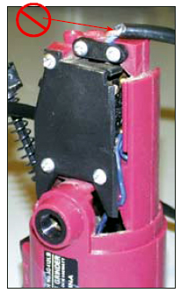
Recognizing Potential Hazards
Undersized wiring
Wire gauge too small
Extension cords
Exposed electrical parts
Cover is removed
Electrical terminals exposed
Source: www.cdc.gov

Slide 10
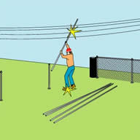
Recognizing Potential Hazards
Overhead power lines
NEC table 110.34(E), elevation of unguarded live parts above working space
Voltage | Meters | Feet
601-7,500 | 2.8 | 9
7,501-35,000 | 2.9 | 9.5
Over 35,000 | 2.9 + 9.5 mm/kV>35KV | 9.5 + 0.37 in/kV>35KV
Notes:
More than 40% of fatalities are from contact with overhead lines (ladders, scaffolding, etc). # 1 cause of electrical fatalities. Most utility distribution lines are uninsulated.

Slide 11
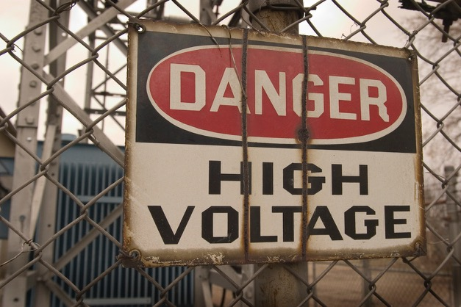
Poll Question
Which is the most, deadly of the following electrical phenomena?
Voltage
Amperage
Wire gauge
Notes:
b) Amperage

Slide 12
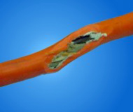
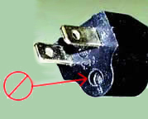
Recognizing Potential Hazards
Defective Insulation
Inspect cords for cracking, fraying, and other signs of wear, or faults in the cord insulation.
Improper Grounding
Inspect the plug for cracks and for missing, loose or faulty prongs.
Source: www.cdc.gov

Slide 13
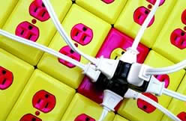
Recognizing Potential Hazards
Overloaded Circuits
NEC 210.20 overcurrent protection
Branch circuit conductors and equipment
NEC 215.3 OCPD for feeders
NEC 240 OCPD locations, enclosures, fuses, circuit breakers, sizing criteria
NEC 310.15 Conductors for General Wiring
(A)(3) Ampacities for Conductors Rated 0–2,000 Volts, Temperature Limitation of Conductors.
No conductor shall be used in such a manner that its operating temperature will exceed that designated for the type of insulated conductor involved.
Source: www.cdc.gov
Notes:
Overcurrent caused by excessive demand

Slide 14
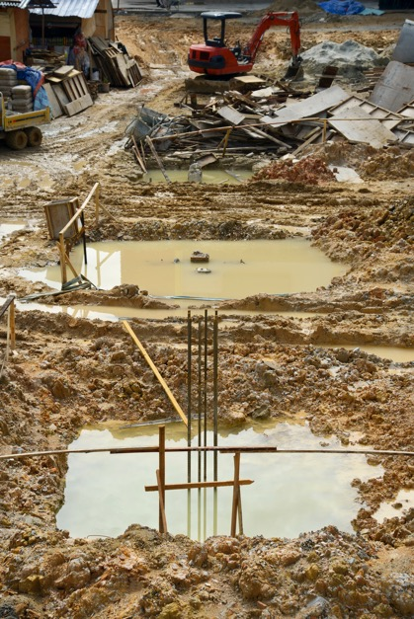
Recognizing Potential Hazards
Wet conditions
Easy path for electrical current
NEC 2011 ARTICLE 310.10 (C) Conductors for general wiring, uses permitted, wet locations
Be moisture-impervious metal-sheathed
Be types W (MTW, RHW, RHW-2, TW, THW and so on)
Be of a type listed for use in wet locations
Notes:
W = wet (higher than damp rating)
MTW = machine tool wiring wet
RHW = thermoset plastic 75C wet
RHW-2 = thermoset plastic 90C wet
TW = thermoplastic 60C wet
THW = thermoplastic 75C wet

Slide 15
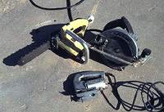
Recognizing Potential Hazards
Damaged Tools
Check for damaged switches and ones with faulty trigger locks
Improper Personal Protective Equipment (PPE)
Never wear clothing made from synthetic materials
Required clothing
Long sleeve shirt
Long pants
Safety glasses
Additional PPE
Source: www.cdc.gov
Notes:
Never wear clothing made from synthetic materials, such as acetate, nylon, polyester, polypropylene, or rayon – alone or combined with cotton. Such clothing is dangerous because it can burn and melt into your skin. Additional PPE like dielectric gloves or protection required by 70E for arc/flash protection may also be required.

Slide 16
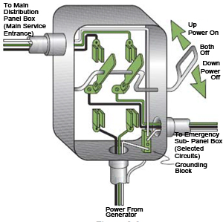
Recognizing Potential Hazards
Backup generators
Use qualified professionals for installation.
For three-phase, three wire generators, a double-pole, double-throw transfer switch is recommended.
For three-phase, four-wire generators
A four-pole transfer switch is recommended for separately derived systems.
A three-pole transfer switch for non-separately derived systems.
Inspect all facility wiring changes or additions.
Inform your electric utility about your backup system!
Source: Center for Construction Research and Training
Notes:
- Permanent standby generators should only be installed by qualified professionals.
- A double-pole, double-throw transfer switch is recommended to keep a single-phase generator from back-feeding into the electrical distribution system. The switch also keeps outside power from re-energizing wiring while the generator is running, protecting the generator, wiring and equipment from damage when service is restored.
- For three-phase, four-wire generators, a four-pole transfer switch is recommended for separately derived systems (generator neutral is solidly grounded) and a three-pole transfer switch for non-separately derived systems (neutral is not grounded at the generator, but usually only at the service entrance).
- Make sure your local building inspector examines all facility wiring changes or additions.
- Inform your electric utility about your backup system; this information is important to lineworkers when restoring power during an outage.
- If you're not sure that your generator is installed correctly, contact a qualified professional or your local building inspector. Remember, you're responsible for any damage or injuries that result from the improper installation or operation of a generator.

Slide 17
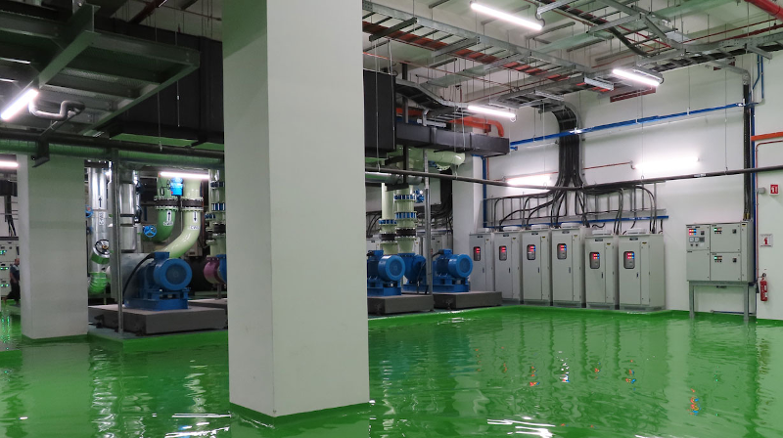
Recognizing Potential Hazards
Source: Water Mold Fire Restoration
Storm restoration
Before re-entering your facility
Check for structural damage.
Make sure all potential electrical hazards are controlled.
Follow chapter 39 of NFPA 5000-2018 building construction and safety code
Determine the degree of damage
Determine the types of equipment being investigated
Determine what liquids were involved, such as water, chemicals, oils, sewage and so on
Find out how long the equipment was exposed to such damage
Consult with the equipment manufacturer when repair or refurbishment is the plan of action
Notes:
The safety of your staff is your priority in any emergency. The following measures will help you stay safe, control damage and get back to business as quickly as possible.
* Stay current about weather and flood conditions using your mobile device, or through television and radio broadcasts.
Before re-entering your facility, check for structural damage and make sure all potential electrical hazards are controlled.
The NFPA 5000 flood-related requirements call for several actions, including the following:
1. Using available flood hazard information for the siting, design, and construction of buildings
2. Elevating buildings above the design flood elevation (DFE)
3. Designing and constructing structures to withstand anticipated flood loads during the design flood event
4. Using flood damage-resistant materials below the design flood elevation
5. In coastal areas, elevating buildings on a pile or column foundation and keeping areas below the elevated buildings free of obstructions,
Determine the degree of damage. Was equipment underwater or did it get wet from rain or other causes?
Types of equipment. Transformers and motors are unique.

Slide 18
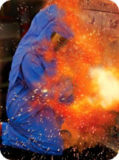
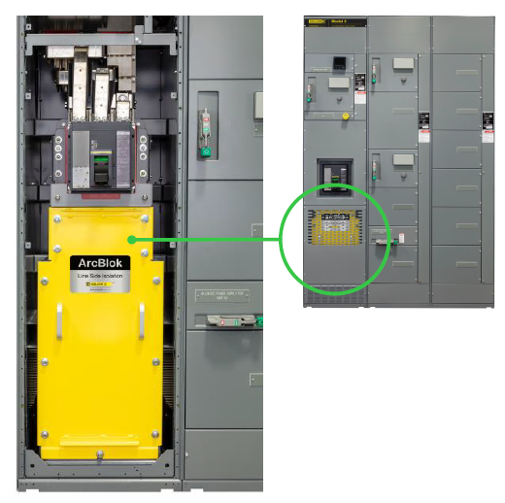
Recognizing Potential Hazards
Arc Flash Hazard
Temperature of the arc terminals can reach approximately 35,000°F
Shrapnel propelled in excess of 700 miles-per-hour.
Deafening loud noise
OSHA 29 CFR 1910.132 personal protective equipment (PPE)
(d)(1) requires evaluating the workplace for electrical hazards and selecting and requiring the use of appropriate PPE to protect employees (ASTM F1506).
(f) requires PPE training (how to wear, remove, maintain).
NFPA 70:NEC-2020 230.62(C) barriers. (New)
Notes:
Arc flash is typically associated with work on overcurrent protection devices such as circuit breakers or switchgear.
Arc flash is the result of a rapid release of energy due to an arcing fault between a bus bar and another bus bar, neutral or a ground. The cause of the short normally burns away during the initial flash and the arc fault can be sustained by the establishment of a highly-conductive plasma. The plasma will conduct as much energy as is available and is only limited by the resistance of the arc which is generally very low.
There have been 134 fatalities from arc flash from 1984 to 2017 (4 per year).
NFPA 70:NEC-2020 230.62(C) Barriers. Barriers shall be placed in service equipment such that no uninsulated, ungrounded service busbar or service terminal is exposed to inadvertent contact by persons or maintenance equipment while servicing load terminations.

Slide 19
Safe Work Practices
NFPA 70E:2015Article 130 work involving electrical hazards
Instruction on safe work practices (alertness, illumination, clothing, tools).
Select personal and other protective equipment.
Article 130.5 Incident Energy Analysis, labeled
Table H.3(b) in Annex H (cal/cm²)
OR PPE Category Method
Table 130.7(C)(15) Hazard/Risk Category (1-4), Gloves/Tools
Table 130.7(C)(16) Protective Clothing and PPE
Table 130.7(C)(14) Protective Clothing Standards
Section 130.5(G) in 2018!
Notes:
Two resources are available to calculate incident energy (cal/cm2): (1) Annex D Incident Energy and Flash Protection Boundary Calculation Methods and (2) IEEE Std. 1584 - 2018, Guide for Performing Arc-Flash Hazard Calculations. If you hold your fingertip over a lit candle for one second, you will experience thermal energy of 1.2 cal/cm2 (threshold of second degree burn). A newly added Table H.3(b) in Annex H lists incident energy exposure in cal/cm2 , as determined by a risk assessment analysis, and corresponding clothing and personal protective equipment. This table is an excellent quick guide for the selection of clothing and PPE.
Table 130.7(C)(15)(a) lists common work tasks and may be used to determine a hazard/risk category. A hazard/risk, including an arc flash analysis, has been performed for each common task listed in the table. The risk analysis (arc flash analysis) is based on parameters that commonly are found in industrial workplaces and are identified as notes at the bottom of the table.
Table 130.7(C)(16) protective clothing matrix is intended to provide helpful information. FR clothing is available in many different constructions. Using FR clothing in layers is one way to achieve a higher level of protection. Table 130.7(C)(16) suggests acceptable combinations of clothing items to achieve a desired hazard/risk category. Other combinations might also be possible. Section 130.7 requires that any body part within the Flash Protection Boundary be protected from the thermal effects of an arcing fault. Defining a hazard/risk category is a viable way to translate incident energy exposure to selection of FR clothing.
Table 130.7(C)(14) is intended to provide general information that could assist a worker understand the process for selecting clothing based on a hazard/risk category designation. This table describes the protective nature of clothing that meets a specific hazard/risk category. Although the table is intended for use in conjunction with Table 130.7(C)(15)(a), it can be used with other methods of determining the necessary protective clothing.

Slide 20
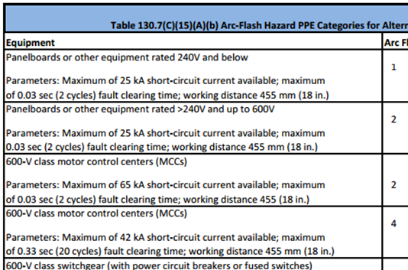
Safe Work Practices
Arc Flash Hazard
NFPA 70E:2015 Electrical safety in the workplace
Table 130.7(C)(15)(A)(a) Qualifier Test
Table 130.7(C)(15)(A)(b) Risk Category Classifications
Not valid if:
Task not listed
Available fault current exceeds listed
Device clearing time exceeds listed
Table 130.7(C)(15)(B) Direct Current Systems Category Classifications
Notes:
NFPA 70E:2012 Table 130.7(C)(15)(a) was split into two tables. The first table is used to determine if an arc flash hazard exists. If an arc flash hazard is present, the second new table is used to determine arc-rated clothing and PPE.
In order to use the tables, the person in charge must verify that the available fault current and the overcurrent protective device (OCPD) tripping time are both equal to or lower than the values assumed for developing the 130.7 tables. This essentially requires performing the majority of the calculations that are necessary for determining the arc flash energy.
An arc flash analysis must be performed for fault-clearing times and short-circuit capacities that exceed the information contained in the notes. The work tasks and protective equipment identified in Table 130.7(C)(15)(a) were identified by a task group, and the protective equipment selected was based on the collective experience of the task group. The protective equipment is not necessarily based on calculations, but it is considered to be reasonable, based on the consensus judgment of the full 70E Technical Committee. The protective equipment identified in Table 130.7(C)(15)(a) considers both electrical circuit parameters and the physical attributes of the equipment and work task.
Category “0” was removed because the new PPE table only specifies work within the Arc Flash Boundary.
Direct current (DC) power applies

Slide 21
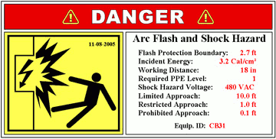
Safe Work Practices
Arc Flash Hazard
NFPA 70E:2015 Article 130.5 (D) labeling requirements.
The nominal system voltage,
Arc flash boundary, and
One of the following:
Available incident energy and corresponding working distance
Engineering analysis method
Required level of PPE
If table method is used
Minimum arc rating of clothing
Highest hazard/risk category (HRC) for the specific site
Source: Mille Mega Power Solutions
Notes:
Only equipment that may require inspections, adjustment, servicing or maintenance while energized are required to have the field marking (label) in place.
Article 130.5(D)— More information is required on arc flash labels. Each label must have
the nominal system voltage,
arc flash boundary, and
one of the following:
available incident energy and corresponding working distance,
Minimum arc rating of clothing,
required level of PPE,
highest hazard/risk category for the equipment.
Arc flash labels applied before September 30, 2011 do not need to be changed if they contain the available incident energy or required level of PPE.
Arc flash hazard program costs could range from $20,000–$30,000 for a large industrial facility to $4,000–$5,000 for a light industrial or commercial facility.

Slide 22
Safe Work Practices
Arc Flash Hazard
NFPA 70:NEC-2014 National Electrical Code
Article 110.16 Arc-Flash Hazard Warning identifies the warning label requirements
Potential arc-flash hazard while energized
Clearly visible
Other than dwelling units
Article 110.21(B) Marking has three marking requirements for warning labels
Labels shall adequately warn of the hazard
Labels shall be permanently affixed
Labels must be durable
NFPA 70:NEC-2017
Article 110.16(B) Warning [New]
System voltage, fault current, clearing time, label date
Source: Mille Mega Power Solutions
Notes:
Neither the NEC nor NFPA 70E preclude using a single label to meet the requirements of NEC 110.16 and NFPA 70E 130.3(C) as long as the label provides the general warning as well as the information on PPE selection.
NEC-2014 made two changes
Switchgear is now specifically called out as requiring labels.
Factory-marking of labels is now allowed
Previously just field-marking was allowed
The 2014-NEC merely stated that electrical equipment must be “field or factory marked to warn qualified persons of potential arc flash hazards”, and recommends that the user check NFPA 70E for guidance. In the new version, article 110.6 (B) explicitly directs that service equipment have the following items on its labels:

Slide 23
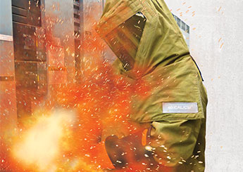
Poll Question
What are the major hazards from arc flash?
High temperature
Shrapnel
Deafening loud noise
All of the above
Source: www.EHS DB.com
Notes:
http://www.ehsdb.com/arc-flash-safety.php
d) All of the above

Slide 24
Safe Work Practices
Fuses fall under 240.67
NEC: 2017 - 240.87 Arc energy reduction (NEW!)
Where the highest continuous current trip setting for which the actual overcurrent device installed in a circuit breaker is rated or can be adjusted to 1,200 amperes or higher then (a) and (b) shall apply.
Limits applicability to Frame N and higher switchgear
(A) Documentation - as to the location of the circuit breakers
(B) Method to Reduce Clearing Time - One of the following or approved equivalent means shall be provided:
(1) Zone-selective interlocking - 2011
(2) Differential relaying - 2011
(3) Energy-reducing maintenance switching with local status indicator - 2011
(4) Energy-reducing active arc flash mitigation system - 2014
(5) An approved equivalent means – 2014
(6) Instantaneous trip setting/override < arc current - 2017
Notes:
To comply with the 2011 code, many system designers were simply implementing instantaneous-trip circuit breakers, but safer technologies now exist. The intent of the 2014 change is to reduce potential arcing time in larger equipment, which typically presents an elevated arc flash hazard.
The 2017 Edition of the NEC now permits the use of the device’s instantaneous trip unit or instantaneous override. To do this, the instantaneous pickup setting of the device must be set below the value of the anticipated arc fault. So as long as there is sufficient arcing short circuit current for it to trip, it can be used.
An N Frame switchgear might be rated from 400A to 1200A and used at 400A. Because it could be raised to 1200A, it must meet 240.87 requirements. Circuits with fuses doe not apply.
(1) Zone selective interlocking
• Communication link between circuit breakers (think and talk to each other)
• Acts to reduce trip times
• Helps reduce arc flash energy
Case 1:
•Both breakers see fault
•Upstream breaker waits as designed
Case 2:
•Only upstream breaker sees fault
•No input from downstream breaker
•Trip as fast as possible
(2) Differential relaying (complex)
•Similar to zone selective interlocking
• Recognizes faults within the zone of protection
• Acts to reduce arc flash
(3) Energy-reducing maintenance switching with local status indicator (flashing light or siren). A second set of more protective settings are enabled via a maintenance switch. These settings are much lower than normal settings thus the breaker trips much faster reducing arc flash.
•Manually or automatically enables an instantaneous pickup
Arc flash relays can use either point or fiber-optic light sensors to detect an arc.
•Reduces arc energy to downstream equipment/personnel
•Limits energy available during maintenance
(4) Energy-reducing active arc flash mitigation system (expensive solid-state solution)
•When activated, this technology continuously monitors current and voltage to identify an arc flash
•When an arc flash occurs, the arc is automatically dealt with, without changes to the circuit breaker
•No change in circuit breaker or the settings of other devices is required during maintenance when a worker is working within an arc-flash boundary
(5) An approved equivalent means (such as fuses)
•Confirm approved equivalent means by requesting a copy of arc flash study
•Compare with one of the four listed methods
•AHJ should approve if arc energy is equal or less than other four means
(6) Instantaneous trip setting/override
An accompanying analysis ensures arcing current is higher than the instantaneous trip setting of the circuit breaker.
What about fuses? Well, in the new NEC 2017, fuses/fusible switches finally get an arc energy reduction article to call their own. Article 240.67 [New] addresses the requirements for arc energy reduction for fuses rated 1200 amp or higher.
The idea behind 240.67 is to reduce the clearing time at the available arcing current. If the fuse’s clearing time is more than 0.07 seconds, then one of the following methods for reducing that clearing time must be used:
Differential relaying
Energy-reducing maintenance switching with local status indicator
An energy –reducing active arc flash mitigation system
OR an approved equivalent means can be used.

Slide 25
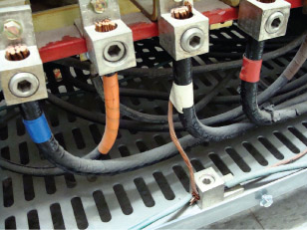
Safe Work Practices
NEC: 2014 New requirements
110.26 Spaces about electrical equipment
Egress requirements now apply to smaller equipment.
Reduced to 800 amps from 1,200 amps.
450.10 Transformer grounding (A) dry-type transformer enclosures
A common terminating (terminal) bar is now required in the transformer.
For primary equipment grounding conductors and supply-side bonding jumpers.
517.17, 700.27, and 701.27 Selective coordination for overcurrent protection
Broadens scope of application to ground faults and short circuits (not just overloads).
Requires design by engineer level competency.
Source: Electrical Service Solutions, Inc.
Notes:
http://ecmweb.com/bonding-amp-grounding/basics-bonding-and-grounding-transformers
Duke W. Schamel, Electrical Service Solutions, Inc.

Slide 26
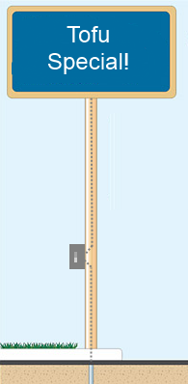
Safe Work Practices
NEC: 2014 New Requirements
600.6 Disconnects for electric signs and outline lighting (A) location (1)
The disconnect location should be the point that the conductors enter the sign.
Assures that all the conductors inside the enclosure are de-energized by the disconnect
700.16 Emergency Illumination
Emergency illumination must be provided to illuminate the indoor service or building disconnecting means.
So that an injured electrician can be easily located by first responders
Notes:
Energized supply wires sometimes enter a sign body at points located apart from the disconnect switch location (e.g. through the sign's backing) and then traverse the sign's interior to the disconnect switch. Thus, even when the disconnect switch is "off," supply wires within the sign body remain energized. Shutting off the switch, therefore, does not necessarily disconnect all of the sign's internal wiring. Thus, a technician repairing the sign assumes that the power is "off" and might be electrocuted when contacting these live conductors.

Slide 27
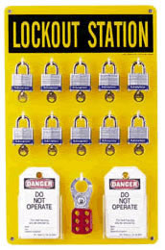
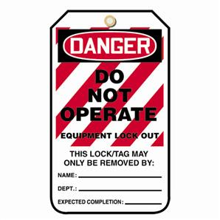
Safe Work Practices
OSHA 29 CFR 1910.147 Lockout/Tagout
(c)(1) Energy control program
Requires energy control procedures, employee training and annual inspections.
(c)(2)(i, ii) Control devices
Lockout, unless not capable (means of attaching a lock).
Lockout, unless you can prove tagout system will provide full employee protection.
(c)(9) Notification of Employees
Notify affected employees before applied and after removed.
(d)(6) Verification of Isolation
Prior to starting work, the authorized employee shall verify that isolation and deenergization of the machine or equipment have been accomplished.
NFPA 70E Article 120.2(B)(4) [New]
Demonstrated training every three years
Notes:
Control of hazardous energy (lockout/tagout), general industry (29 CFR 1910.147) was the 6th most frequently cited standard and 4th highest penalties paid in fiscal 2010.
Capable of being locked out. An energy isolating device is capable of being locked out if it has a hasp or other means of attachment to which, or through which, a lock can be affixed, or it has a locking mechanism built into it. Other energy isolating devices are capable of being locked out, if lockout can be achieved without the need to dismantle, rebuild, or replace the energy isolating device or permanently alter its energy control capability.
Affected employee. An employee whose job requires him/her to operate or use a machine or equipment on which servicing or maintenance is being performed under lockout or tagout, or whose job requires him/her to work in an area in which such servicing or maintenance is being performed.
Authorized employee. A person who locks out or tags out machines or equipment in order to perform servicing or maintenance on that machine or equipment. An affected employee becomes an authorized employee when that employee's duties include performing servicing or maintenance covered under this section.

Slide 28
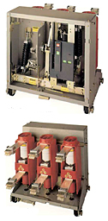
Protection Devices
Circuit breakers
Low-voltage (<600 volts)
Molded case, insulated case, or metal frame
Trips by bimetallic strips, magnetic (solenoid), and hydraulic magnetic technology
Medium-voltage (>1,000 volts and <72.5 kv)
Trips by instantaneous overcurrent, time overcurrent, and overvoltage
Metal-clad switchgear (image at right)
Metal-enclosed switchgear
Image used with permission of Schneider Electric. © 2009 Schneider Electric, All Rights Reserved
Notes:
Metal-Enclosed Power Switchgear: A switchgear assembly completely enclosed on all sides and top with sheet metal (except for ventilating openings and inspection windows) containing primary power circuit switching or interrupting devices, or both, with buses and connections. Metal-enclosed switchgear uses interrupter switches for load switching and power fuses for fault protection.
Metal-clad switchgear requires that the main switching and interrupting device be drawout. Metal-clad switchgear uses draw-out air-magnetic or vacuum circuit breakers and relays for both load switching and fault protection. Low voltage switchgear cannot be considered metal-clad.
People normally consider a breaker's or fuse's (protective equipment) current rating where it will open to interrupt current to protect from overloading the circuit. However, they don't always think about the maximum current a protective device can handle without failing. An electrical engineer should calculate the maximum fault current available where new equipment will be located. Then, the protective equipment can be selected with a fault current rating equal to or greater than the available fault current at that location. If the protective device is not rated to handle the fault current that it would see, it could fail and potentially fail violently.

Slide 29
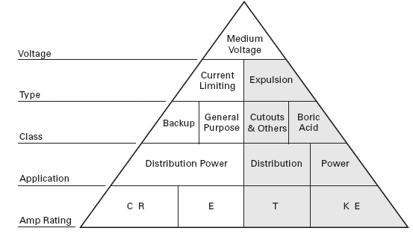
Protection Devices
Fuses
Cheaper than circuit breakers
Clears heavy fault currents in less time
Often delay for minutes
Current-limiting
Silver or copper strip fuse elements
Reduced cross-sectional areas heat up and melt very quickly
Can clear a fault within 1/2 cycle (0.008 sec)
Image courtesy of Norberg @ chfuses.com
Notes:
Fuses fail in ~0.014 seconds versus ~ 0.083 to 0.133 seconds, plus relay time for circuit breakers.

Slide 30
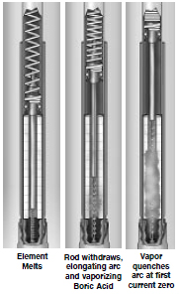
Protection Devices
Fuses
Non-current limiting (expulsion)
Metal arcing rod with one end attached to a silver fusible element and the other end attached to a spring.
Spring retracts the rod and the arcing action decomposes the surrounding boric acid.
Arc is extinguished only at the zero switching current point of the AC sine wave.
This may take 1 to 2 AC cycles and during this period no significant current limitation occurs.
Image used with permission of Cooper Bussmann
Notes:
Arcing rod is wrapped in a boric acid cylinder. The resultant elongated arc and blast of water vapor and boric anhydride extinguishes the arc.
Gases are expelled from the bottom of the fuse.

Slide 31
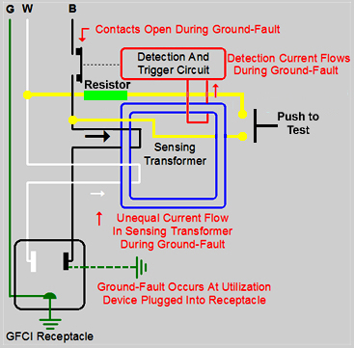
Protection Devices
Ground-fault circuit interrupter (GFCI)
NEC GFCI Requirements
Art. 210 Branch Circuits
Art. 215 Feeder Circuits
Art. 517 Healthcare Facilities
Protects people directly, equipment indirectly
Minimizes shock (< 5ma)
Receptacle, circuit breaker, or portable types
Test once per month
Always use test lamp

Slide 32
Protection Devices
Ground-fault circuit interrupter (GFCI)
Bathrooms
Kitchens
Rooftops
Near sinks
Spray washers*
Vending machines*
Drinking fountains*
Safety showers
Eyewash stations
Locker rooms w/showers
Swimming pools
Indoor wet locations
Outdoor receptacles
Automotive pits
Elevator car tops
Escalator and moving walkways
Machine rooms
Aircraft hangars
Construction sites
Fountains (with exceptions)
Commercial garages/service bays
Vehicle tire inflation and vacuum machines*
Crawl spaces (2017)
Unfinished basements (2017)
Lagoon piers (2017)
*Includes three-phase through 2014
Notes:
New NEC 2014 requirements are highlighted in red, NEC 2017 in blue.
Most of this list is for single-phase service. Three-phase is noted by the asterisk* for NEC 2014 requirements.
Swimming pools (including lights, pool covers and fans) 680.21 Motors (C) Ground-Fault Circuit-Interrupter (GFCI) protection
Amperage rating has been removed as qualifier for swimming pool motor GFCI protection.
Beginning with NEC 2017, GFCI protection applies to all single-phase receptacles rated 150 volts to ground or less, 50 amperes or less and three-phase receptacles rated 150 volts to ground or less, 100 amperes or less installed in the same locations above plus three more:
Crawl spaces
Unfinished basements
Lagoon piers

Slide 33
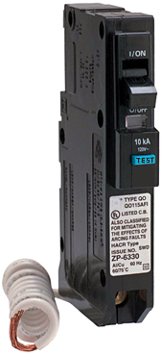
Protection Devices
Arc-Fault Circuit Interrupter (AFCI)
Protects materials directly, people indirectly
Mainly from fires caused by arcs
Normal arcs do not cause tripping
2017 NEC 210.12 AFCI Protection [NEW]
(B) Dormitories
(C) Lodging guest rooms
Not required in bathrooms, unfinished basements, garages and outdoors.
Existing facilities where branch-circuit wiring is modified, replaced, or extended
Source: www.cpsc.gov
Series Fault
Parallel Fault
Notes:
210.12(B) Branch Circuit Extensions or Modifications—Dwelling Units and Dormitory Units
The existing requirements for arc-fault circuit-interrupter (AFCI) protection of branch-circuit extensions or modifications in dwelling units have been expanded to include dormitories. The same hazards exist in dormitories. AFCI protection in dormitories is expanded to include all outlets and devices in dormitory bathrooms.
210.12(C) Guest Rooms and Guest Suites
New subdivision (C), Guest Rooms and Guest Suites, has been added to Section 210.12. All 120V, single-phase, 15A and 20A branch circuits supplying outlets and devices installed in guest rooms and suites of hotels and motels must be protected by any of the AFCI methods listed in 210.12(A)(1) through (6). This new AFCI requirement applies to all guest rooms and suites without regard to cooking provisions.
It applies in new construction or in existing homes where branch-circuit wiring is modified, replaced, or extended greater than six feet if no other outlets or devices are added.

Slide 34
Poll Question
One of these things is not like the others:
AFCI
GFCI
Circuit breaker
Notes:
b) GFCI protects people. Circuit breakers and AFCI protect equipment.

Slide 35
Safety Ideas
ANSI Z10-2012
Occupational Health and Safety Management Systems
Hazard Control Methods
Elimination
Substitution
Engineering Controls
Warnings
Administrative Controls
Personal Protective Equipment
Control Effectiveness
NFPA 70E
Notes:
NFPA70E -2009 110.7 (A) Electrical Safety Program references ANSI Z10 in FPN No. 2.
ANSI Z10 provides a framework for establishing a comprehensive electrical safety program as a component of an employer’s occupational safety and health program.

Slide 36
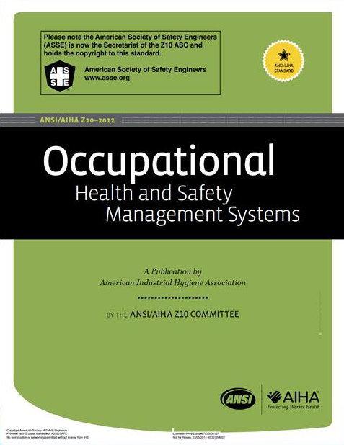
Safety Ideas
ANSI Z10-2012 Hazard Control Methods
Warnings
Visible/audible signs, barriers, labels
Administrative controls
Hazard assessments
Lockout/tagout
Audits
Equipment maintenance
Personal protective equipment
Available
Effective
Easy-to-use

Slide 37
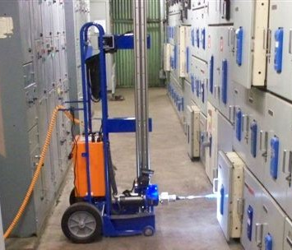
Safety Ideas
ANSI Z10-2012 Hazard Control Methods
Elimination (during design)
Move break area from switchgear room
Substitution (less hazardous equipment)
Reduce transformer size
Current-limiting fuses
Smart motor control centers
Engineering controls (automatically reduces risk)
High resistance grounding
Remote racking for draw-out circuit breakers
Source: PDS, Inc.
Notes:
http://www.pdsinc.biz/universal-circuit-breaker-rrs/
Elimination - Removing the hazard at its source
Substitution - Replacing a severe hazard with a less severe one
Engineering Controls - Blocking the hazard from affecting employees. Remote racking reduces risk without human intervention.

Slide 38
Safety Ideas
Forming a Safety Committee
Duties
Safety policy meets all applicable OSHA regulations
Routine inspections of all equipment and work processes
Investigate all workplace accidents and safety violations
Keys to Success
Management support
Multi-function committee makeup
Clear committee goals
Safety Professional
Electrical Expert
Management
Notes:
Management Support—Safety experts agree that management support is key in an effective safety committee. In addition to providing resources, management should be involved in setting the goals and objectives of the committee. Management support can come in a number of ways including the following:
Setting a good example by following established safety rules
Emphasizing health and safety issues through meetings, training, and signage
Strictly enforcing safety policies recommended by the safety committee
Cross-Company Committee Makeup—To be effective, the safety committee should include members of all departments or divisions within the organization, including labor, management, and a representative from human resources to help ensure that everyone is represented fairly.
Clear Committee Goals—Before beginning work, the committee must have a clear set of objectives and a detailed list of functions. Ideally, the committee should have a charter that describes exactly what it plans to accomplish and the limits of its authority. This document should detail the following:
Specific makeup of the committee
Primary functions including inspections, auditing, training, and more
Schedules for committee meetings and programs
Committee outputs including reports, policy handbooks, recommendations, and so on

Slide 39
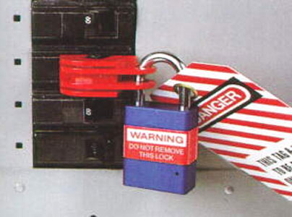
Safety Ideas
Turn it off!
OSHA 1910.333(a)(1) Selection and use of work practices
“Live parts to which an employee may be exposed shall be deenergized before the employee works on or near them, unless the employer can demonstrate that deenergizing introduces additional or increased hazards or is infeasible due to equipment design or operational limitations..“
Focus on the rule, not the exception
Source: Jim White, training director for Shermco Industries
Source: California Division of Occupational Safety and Health
Notes:
Also in Section 130.1(A)(2) of NFPA 70E
(2) Infeasibility. Energized work shall be permitted where the employer can demonstrate that the task to be performed is infeasible in a deenergized state due to equipment design or operational limitations.
The code allows exceptions, but don’t take the easy way out!

Slide 40
Safety Ideas
Annual Field Safety Audits.
What is inspected, can be expected
Train your employees
OSHA 1910.332 Electrical Training
Anyone who performs work on such systems
Anyone who supervises workers who do such work
Anyone who works around the equipment (NEW)
Shall receive training on the Electrical Safety-Related Work Practices
De-energizing equipment
Application of locks and tags
Distinguish exposed live parts from other parts
Determine the nominal voltage of exposed live parts
Source: Jim White, training director for Shermco Industries
Notes:
Can be a signed checklist, but really is more of an audit. People typically can’t be relied on to follow the practices precisely. Work gets in the way (productions schedules, etc)! Safety audits keep the issue in the forefront.
Train employees every three years.

Slide 41
Safety Ideas
Define a Qualified Person
OSHA 1910.399 Definitions applicable to this subpart
Has received training
Has demonstrated skills and knowledge
NFPA 70E Article 100
Documented demonstration of identifying hazards
Assess the Hazards
NFPA 70E: 2018 requires a job safety plan before work tasks begin (NEW)
Osha 1910.132(d)(1) personal protective equipment
Hazards are present
Hazards that are likely to be present
Must produce a certification of hazard assessment document
Source: Jim White, training director for Shermco Industries
Notes:
The 2015 version of the NFPA 70E standard adds the requirement that such a qualified person shall demonstrate the ability to use—and not just be familiar with the proper use of—the following:
Special precautionary techniques
PPE including arc flash suits
Insulating and shielding materials
Insulated tools and test equipment
Written document that you assessed the hazards.

Slide 42
Poll Question
How valuable has this webinar been to you?
Not valuable at all
Slightly valuable
Moderately valuable
Very valuable
Extremely valuable

Slide 43
Safety Ideas
Conduct Job Briefings
Hazards that may be encountered
What personal protective equipment (PPE) is to be used
Emergency contact numbers and procedures
Any extraction procedure or other emergency procedure that may be needed
What work is being done in the area
If any work is being done on the circuit you are working on
Source: Jim White, training director for Shermco Industries
Notes:
Plan for worst case scenarios. How to extract people from accident site. Don’t wait until it happens.

Slide 44
Safety Ideas
Enforce PPE use
OSHA 1910.335(a)(1)(i) Safeguards for personnel protection.
Employees … shall be provided with, and shall use, electrical protective equipment.
Check Employee Impairment
Employees cannot perform energized work if unable to do so safely.
A worker can be impaired by alcohol, illness, lack of sleep, or over-the-counter medications.
No Shortcuts!
Never tell someone to do something you know is unsafe.
Source: Jim White, training director for Shermco Industries
Notes:
"I Fought the Law (and the Law Won)." - Bobby Fuller, 1965
Employees working in areas where there are potential electrical hazards shall be provided with, and shall use, electrical protective equipment that is appropriate for the specific parts of the body to be protected and for the work to be performed.
No shortcuts. Accidents occur very quickly.

Slide 45
How You Can Help
If you own and operate your own station:
Ensure you are maintaining your equipment, as per your specific required preventative maintenance cycle time
Ensure your contact information is kept up to date in PSE&G records
Ensure PSE&G has access to your site
If you are a primary customer:
Ensure your generator is well maintained
Settings for generators and UPS systems should be coordinated with PSE&G system
Inform you Customer Advisor of any changes in site contact information as soon as possible

Slide 46
How You Can Help

Slide 47
Additional Resources
Electrical Safety Foundation International
Never Assume Electrical Safety Series
National Institute for Occupational Safety and Health (NIOSH)
Arc Flash Awareness
IEEE industry application society (IAS)
Electrical Safety Workshop
NFPA 70: NEC Annex E Electrical Safety Program
Notes:
The Never Assume Electrical Safety Series is a collection of advanced safety awareness video modules created for electricians, safety directors, construction professionals and facilities managers. From job planning to proper PPE, this video program is a must for anyone working with or near electricity.
ARC FLASH AWARENESS
Information (first-person testemonials) and Discussion Topics for Electrical Workers
Since its inception in Toronto in September 1991, the IEEE IAS Electrical Safety Workshop has provided the premier international forum to enable and accelerate change in the electrical safety culture and pushing the envelope on what is possible in preventing workplace injuries from electrical hazards.

Slide 48
Questions
Notes:
Q – Can I trim the bushes and weeds from my transformers myself?
A – If it’s a PSE&G owned transformer, please be safe and call 1-855-249-7734 and schedule a maintenance visit by PSE&G (No Charge during business hours)
Q – How far away must I be from an energized power line?
A – OSHA requires a minimum distance of 10 feet from any power line, energized or not. That includes location of scaffolding.
Q – How many devices can I safely connect to a standard 120V outlet?
A – Most receptacles are protected by a 15 AMP breaker. Generally, add up the Wattages of all the devices (using device nameplate data) to ensure they do not total in excess of 1800 Watts (120V x 15A single phase = Wattage)
What is the difference between OSHA and NFPA 70E requirements?
OSHA enforces workplace safety under the law, but the OSHA electrical safety standards are not prescriptive. The requirements of NFPA 70E are prescriptive, but are not mandated by law; however, they are considered to be the minimum consensus requirements for safe electrical work procedures, and OSHA may use them as the basis for issuing citations.

Slide 49
Thank You!
This document was specifically prepared to aid utility account managers. Any other use of this material (in whole or in part) is prohibited without the written consent of Questline, Inc. Questline has received source permission to use the images found in this presentation. All recipients must also obtain source permission before reusing the content in any other form.

